Slide 1

How-to: Submitting Public Comments to Texas House Committees
For those times you don't have a microphone handy

Slide 2
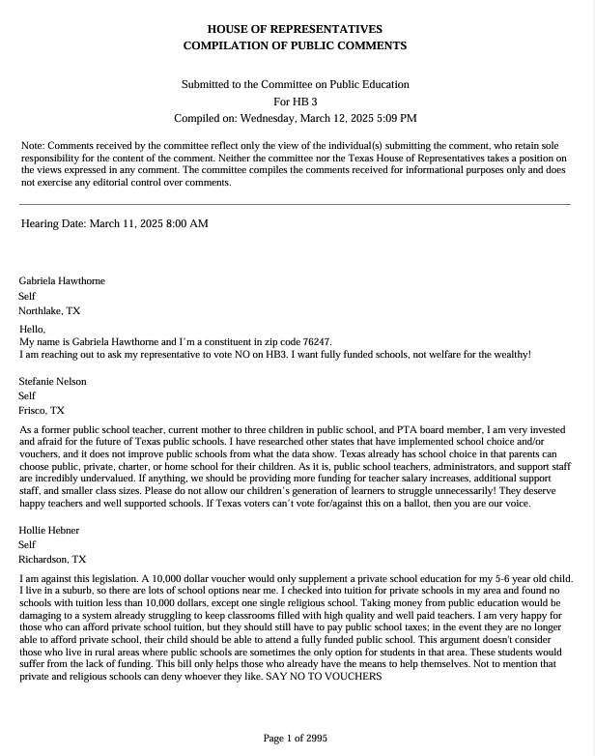
What are public comments?
The Texas House has an online form that you can use to submit written comments to House committees on various bills: comments.house.texas.gov/home.
These comments will be distributed to House committee members, and they will be made publicly available online.
For example, voucher bill HB 3 generated 2,995 pages of public comments.

Slide 3
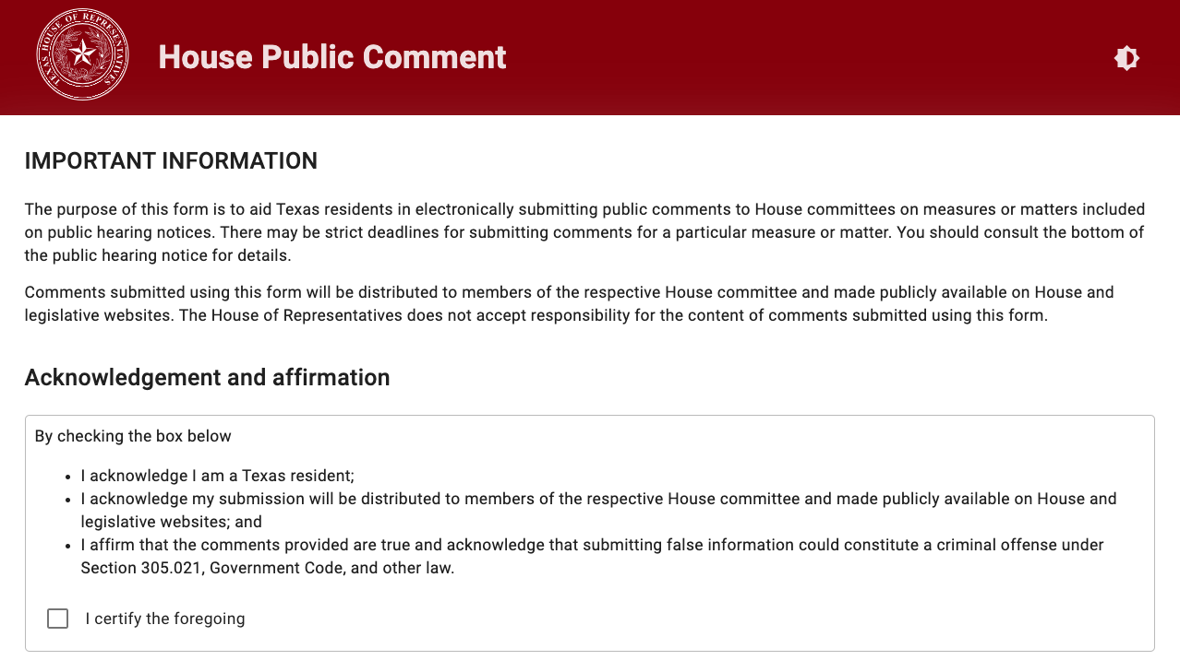
Why are public comments important?
These comments give legislators on a committee hard proof of where constituents stand on issues.
They also allow you to provide your thoughts on bills without having to go to the Capitol or provide digital testimony.
These comments stay on the public record.

Slide 4

Before writing your public comment
Your comments must be under 3,000 characters (around 500 words).
You must be a Texas resident to submit a comment.
When the online form asks who you're representing, please enter "self" and your occupation. Do not list AFT, your local union, or your school district.
To find the bill you want to comment on, you can either search for the bill number (e.g., HB 3 or hb 3) or you can scroll to find the committee it's being heard in.
Note: Bills will appear in the portal when a committee agenda is posted – at least 72 hours before the hearing.

Slide 5
While writing your public comment
What to include
Be respectful – this is public!
Be clear about the bills or issues you're addressing.
Focus on facts. Do your research ahead of time and check any relevant details or talking points before you submit.
Make your comments personal and link them to the bill or issue. Identify yourself as an active or retired educator.
Be specific about what you want them to do or what votes you want them to take.
Use "I' statements wherever possible.
Be passionate while also polite and professional. Do not personally attack or mention the bill author.
End with a thank you … even when you don't feel like it.

Slide 6
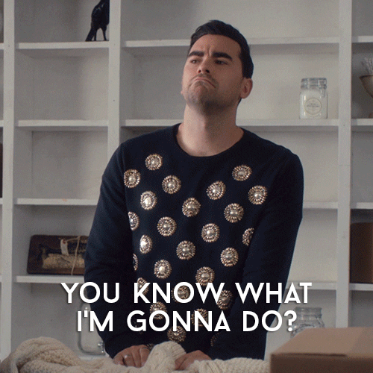
After submitting your public comment
Let your friends, family, and colleagues know about the issue and urge them to submit comments too. Bills will be open for comments until the committee hearing ends!
Call the legislators on the committee at their offices and share your comments with their staff over the phone. (They have to log these!)
Take the text of your public comment and turn it into a letter to the editor of your local newspaper to amplify its reach. (You may have to trim it slightly.)
Use your public comment as a script for a short social media video or post the full thing with a link for others to submit theirs.

Slide 7
https://comments.house.texas.gov/home

